Slide 1

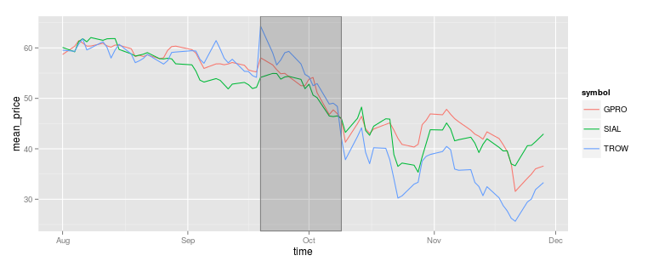
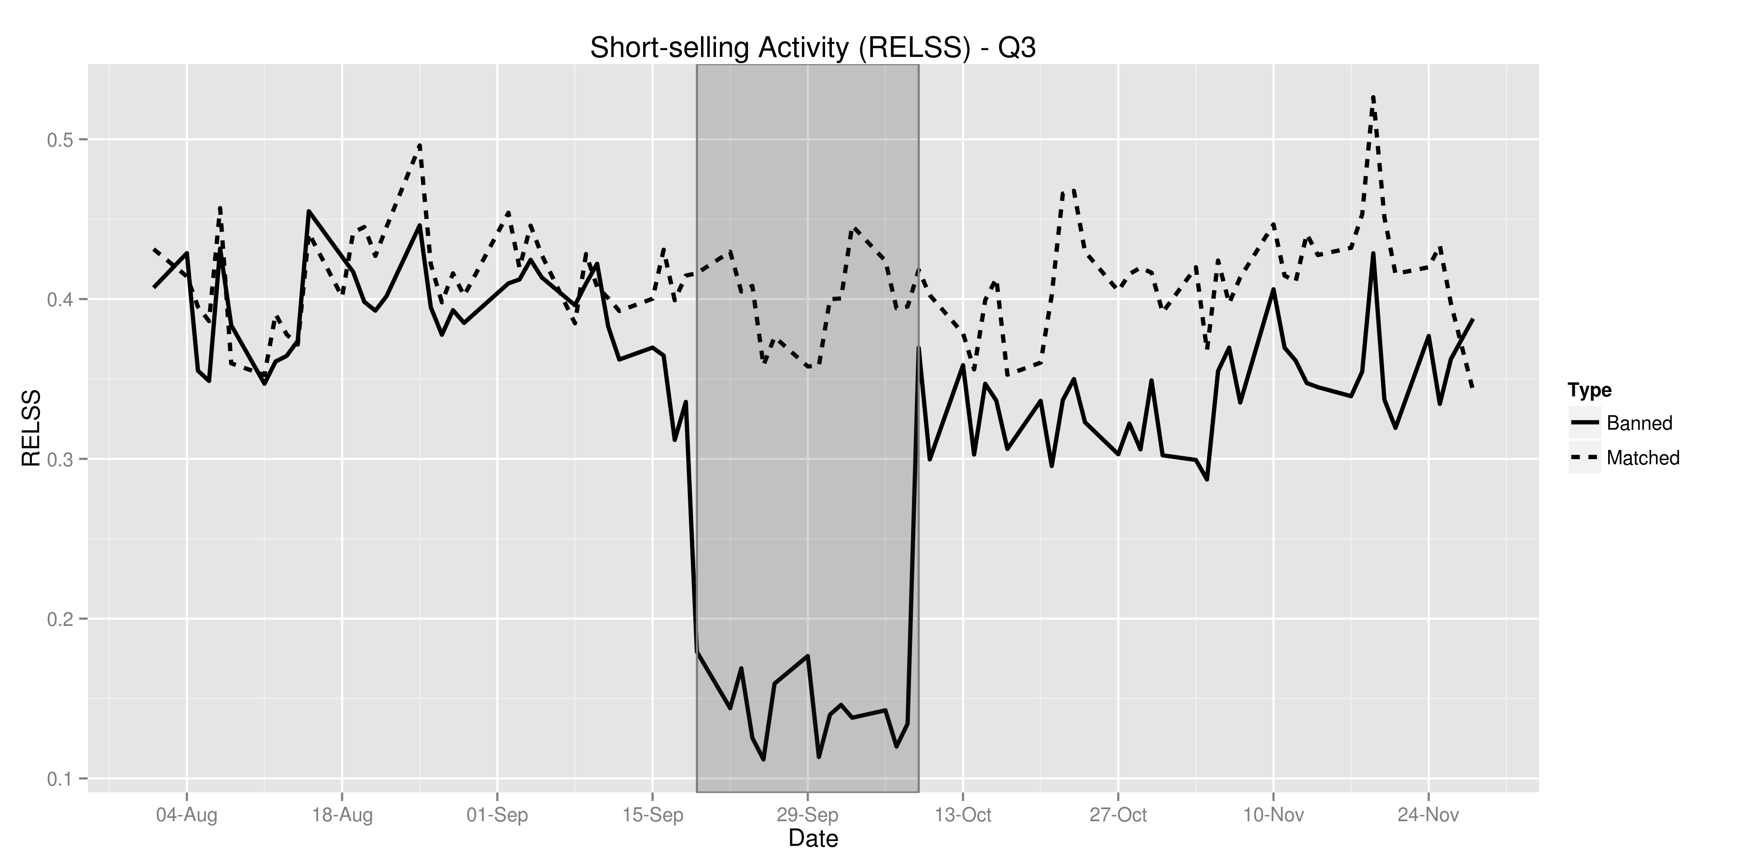
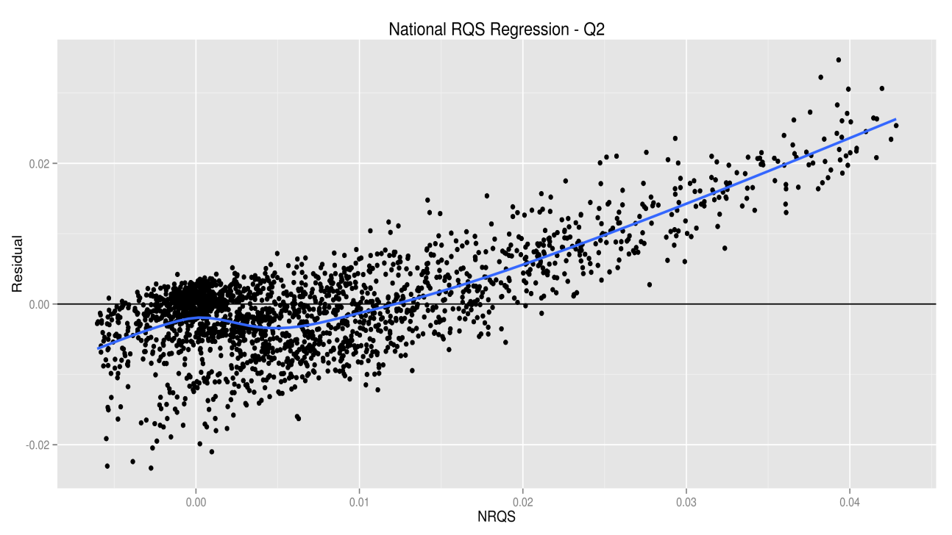

The Need for Speed: High Frequency Finance and Short Selling
Jonathan Gillett ● Ryan Riordan ● Jonathan Brogaard Faculty of Business and IT ● University of Ontario Institute of Technology ● Oshawa, Ontario, Canada
Introduction
Results
Methodology
Data Processing
NASDAQ
TAQ
Database Identifying HFT and Short-Sales
Trade And Quote Database
Merge NASDAQ databases identify HFT and short-sales with TAQ data
Creation of time and trade weighted datasets to be used for analysis
Data Analysis
Calculation market quality measures and descriptive statistics
Matching banned stocks to a control group of unbanned stocks based on price, volume and market capitalization
Conclusions and Further Research
Visualization of market quality measures and descriptive statistics to aid in creating the initial design of the statistical models for regressions.
Statistical Modelling
Creation of statistical models
References
Assessment of models based on regression analysis with datasets
Models do not accurately explain the results based on the datasets
Acknowledgements
Models explain the results with statistical significance
$RQS \sim ssb+market_{cap}+sum_{vol}+ hft_a + hft_a ∗ ssb$
Notes:
1

